Slide 1

Unmanned Remotely controlled Fire Fighting Robot
Submitted by,
S
P
K
Year: 2019-2020

Slide 2
Abstract
In this era of technological advances, process automation and robotics have played a vital role. Replacing human labor force with robots have many advantages. Robots are less prone to errors. They can be remotely controlled or completely autonomous. Firefighting is a dangerous profession. In firefighting profession, human lives are at stake every now and then. Replacing humans with robots for firefighting will save several number of human lives.
So, This project is designed to develop a fire fighting robot using Wi-Fi technology for remote operation. The robotic vehicle is mainly loaded with camera for image processing, water tanker and pump which is controlled over wireless communication for fire detection and to throw water respectively.

Slide 3
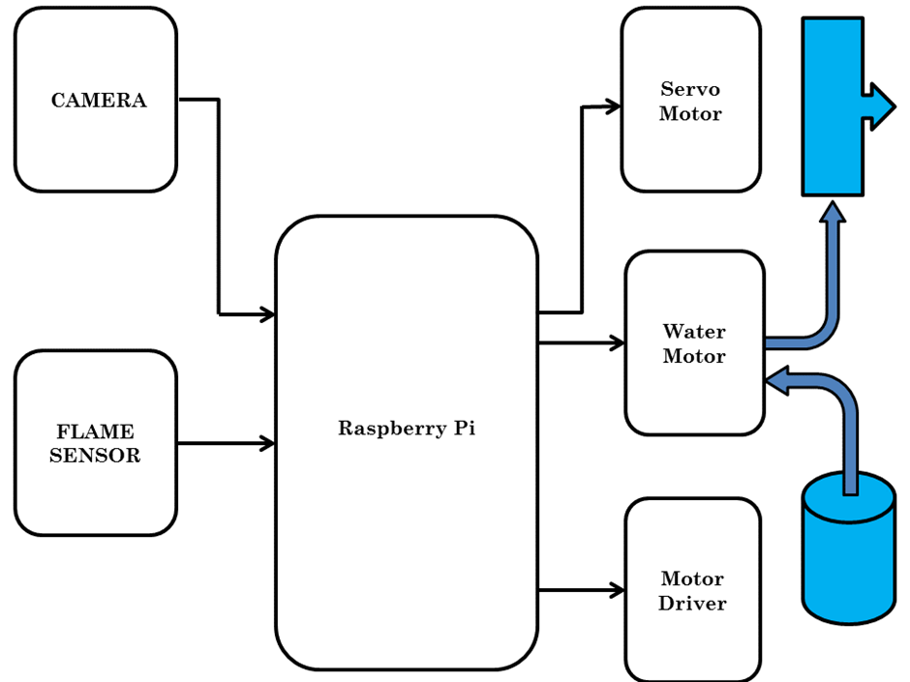
Block Diagram
Fig. Block Diagram of Unmanned Remotely Controlled Firefighting Robot

Slide 4
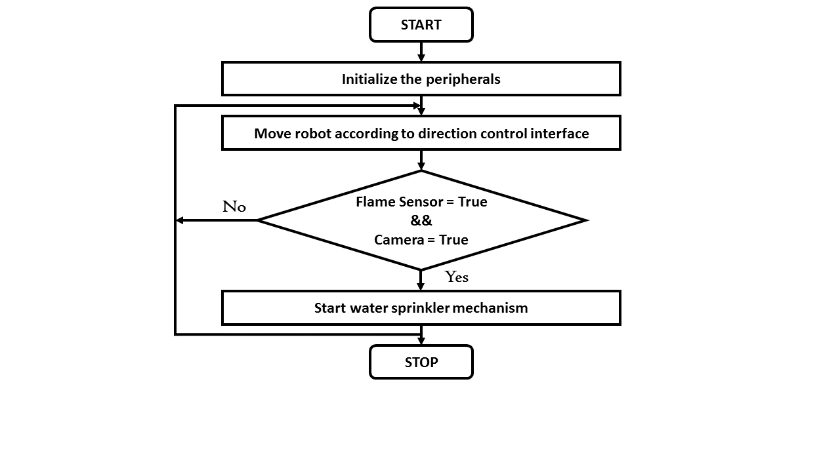
FLOW CHART
Fig. Flow Chart of System

Slide 5
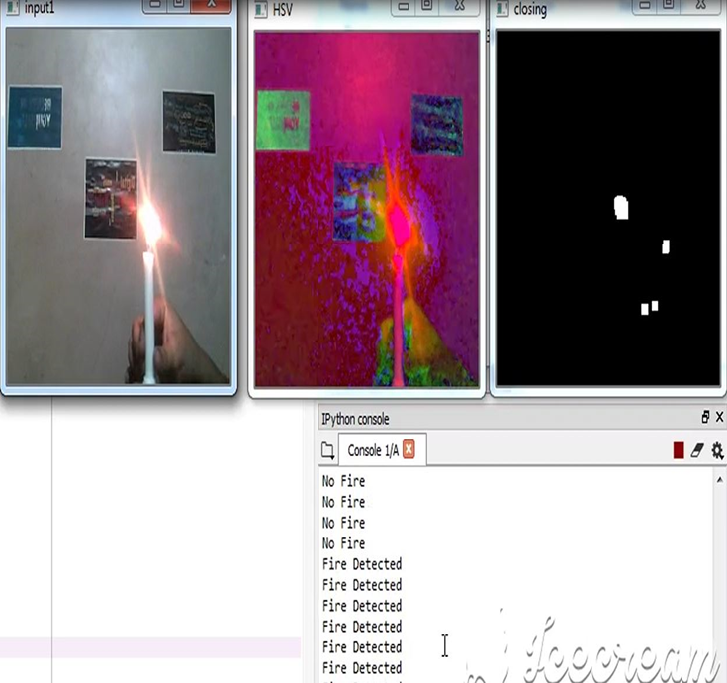
RESULTS
1.IMAGE PROCESSING:DETECTING FIRE

Slide 6
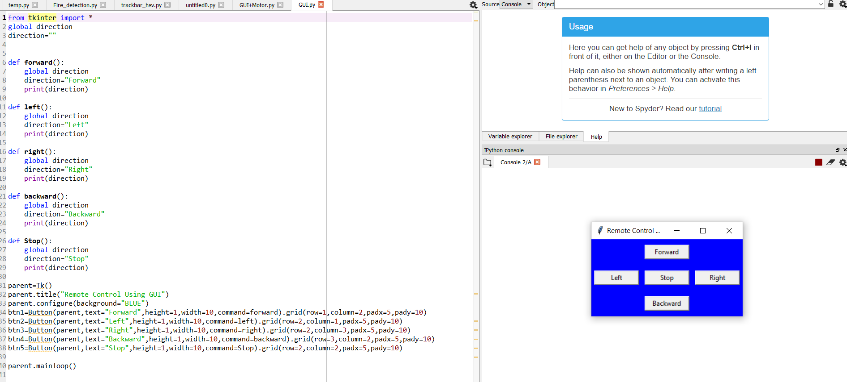
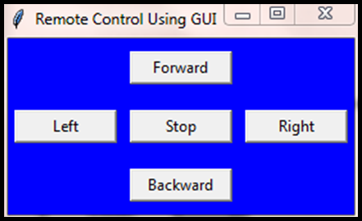
2.GUI-GRAPHICAL USER INTERFACE
for remotely control of vehicle using Wi-Fi technology
This is the GUI with which we can control the direction of the robot.

Slide 7
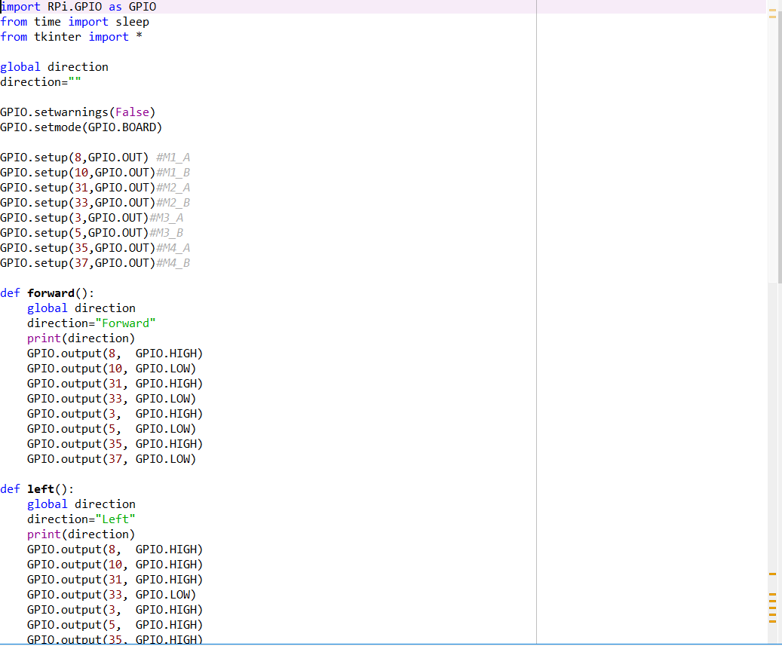
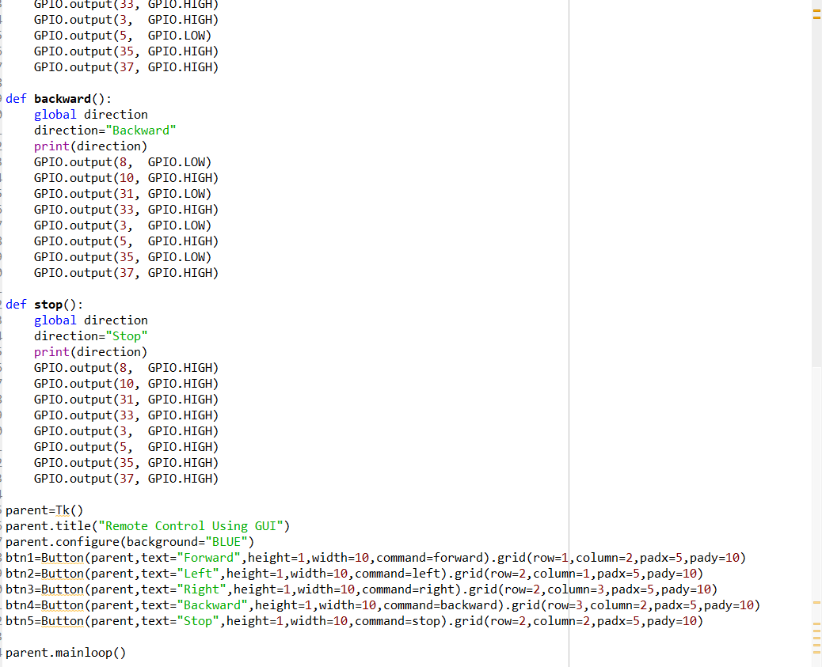
3.Code built for motor to interact with GUI using Tkinter

Slide 8
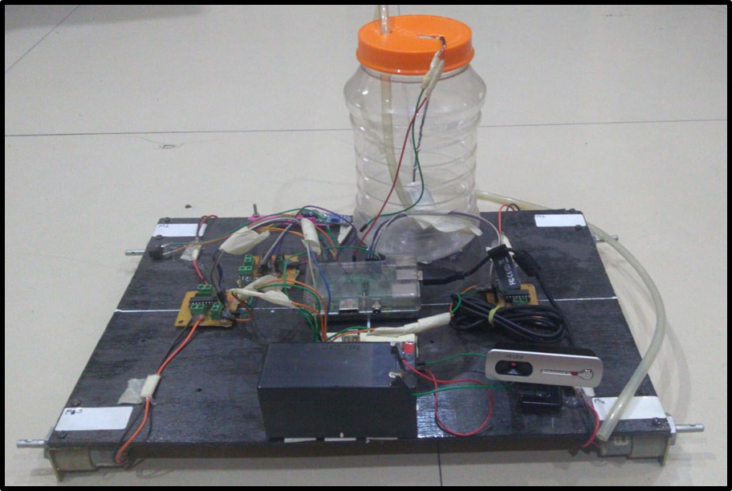
4.Image Representation of work done on our fire extinguishing robot before lockdown
Fig. Image Representation of fire extinguishing robot

Slide 9
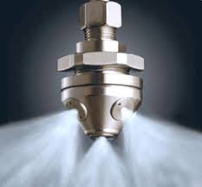
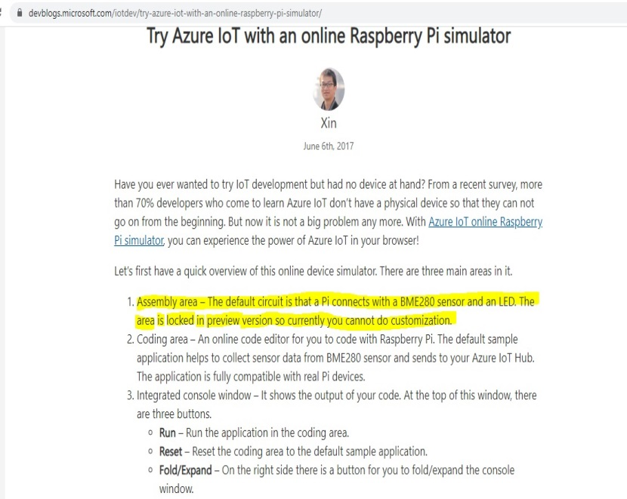
CHALLENGES AND EXPLORATIONS
1.Our algorithm for image processing was not working accurately,then we changed the platform to spyder,an open souce software for better user interface.
2.Fire detection was one of the major part of this project and it needs to be accurate but we were not getting accurate results in pixels for image processing. So we used HSV algo.
3.A component of our project,that is nozzle of the water tanker to throw the water was not available in the market and due to this lockdown, search for it stopped. It is shown below:
4.Due to this lockdown,we tried to explore for simulation
for our project. Our hope was microsoft IOT Azure
raspberrypi online simulator but as we explored
further,we get to know that it hasn’t been availabe for
Customization yet.

Slide 10
CONCLUSIONS
In this project, we have planned to propose an unmanned vehicle for fire detection and extinguishing purpose that is remotely controlled.The proposed method promised to be highly beneficial for the security purpose and industrial purpose.
As far as the work is done, system is able to detect fire using flame sensor and camera using open CV. Robot changes direction according to the input given by user using GUI. System will be able to detect fire using both flame sensors and camera with image processing.
But the work of extinguish the fire using water sprinklers is remaining and has been left due to this pandemic and lockdown crisis.
FUTURE Scope:
At present, camera can rotate upto 180 degress but it can made to rotate 360 degress in future.
In future, robot will also be capable of throwing water with controlled robotic arms or the whole water extinguishing system will be replaced with CO2 extinguisher which will make it qualified to use it in large scale and save more lives.

Slide 11
WORK COMPLETED TILL SEMESTER-1
1.Image processing algorithm for fire detection was built but it wasn’t working accurately as it is required.
2.Components selection and individual testing of each component except the nozzle of the
water tanker to throw the water.
3.Chasis board has been built on which whole circuitary is going to implanted.
4.Study of OpenCV language for understanding of HSV algorithm, the algorithm which is best known for purposes like fire detection.
5.Selection of library for building Graphical User Interface was going on but wasn’t selected till the end of semester 1.

Slide 12
PARTNER’S CONTRIBUTION
1.S- How this Robot will detect the fire and the required algorithm of image processing required to detect the fire. Study Of OpenCV and Python language to apply the required action in Anaconda software. Controlling the motor and direction of robot and building GUI using tkinter for easy control of robot using Wi-Fi technology.
2.P - Required Hardware selection and testing of each and every component and building of Chasis board.
3.K - After fire detection, how the robot needs to react and take preventive measures to extinguish the fire and save lives.

Slide 13
REFERENCES
Jayanth Suresh, “Fire-Fighting Robot”, 2017 International Conference on Computational Intelligence in Data Science(ICCIDS)
Ahmed Hassanein, Mohanad Elhawary, Nour Jaber, and Mohammed El-Abd, “Autonomous Firefighting Robot”, 978-1-4673-7509-2/15/$31.00 ©2015 IEEE
Shiva Mittal, Manish Kumar Rana, Mayank Bhardwaj, Meenakshi Mataray, “Ceasefire: The Fire Fighting Robot”, International Conference on Advances in Computing, Communication Control and Networking (ICACCCN2018)
Kirti Kadam, Aayushi Bidkar, Vaishnavi Pimpale, Dhanashree Doke, Rachana Patil, “Fire Fighting Robot”, International Journal Of Engineering And Computer Science ISSN:2319-7242 Volume 7 Issue 1 January 2018, Page No. 23383-23485
Mohd Aliff , MI Yusof, Nor Samsiah Sani, Azavitra Zainal, “Development of Fire Fighting Robot”, (IJACSA) International Journal of Advanced Computer Science and Applications, Vol. 10, No. 1, 2019
Abdülkadir ÇAKIR, Nyan Farooq Ezzulddın EZZULDDIN, “Fire-Extinguishing Robot Design by Using Arduino”, IOSR Journal of Computer Engineering (IOSR-JCE) e-ISSN: 2278-0661,p-ISSN: 2278-8727, Volume 18, Issue 6, Ver. V (Nov.-Dec. 2016), PP 113-119
Shashi Kumar, Vibhash S. Sisodia, “Development of wireless Fire-Detection and multipurpose Extinguisher Robot”, International Journal of Engineering Science Invention (IJESI) ISSN (Online): 2319 –6734, ISSN (Print): 2319 –6726

